Slide 1

LaunchCode Liftoff
Class 3
Hank DeDona
8/16/21

Slide 2
“No one in the brief history of computing has ever written a piece of perfect software. It's unlikely that you'll be the first.” - Andrew Hunt

Slide 3
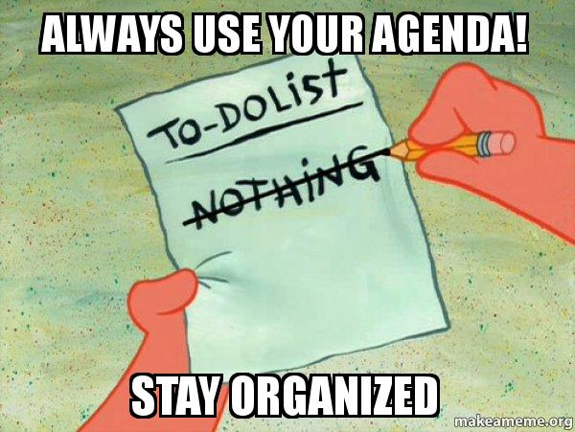
Agenda
Objectives and Timeline
Lecture
Open Source
Personal Branding
Introduce Assignments
Review Objectives
Activity
Stand-Up
Resume Workshop

Slide 4

Objectives
Know What Makes a Good Technical Resume
Utilize LinkedIn to Network with Other Professionals
Know How to Use Your GitHub Account to Showcase Projects

Slide 5
Timeline Review
Capstone Project Selected
Wireframes & Initial Features
Class 1
Class 3
Class 2
Class 4
Wireframes & User Stories
Project Review 1

Slide 6
Preparing for Tech Interviews
Notes:
Advocate for personal branding
Build networks, know what’s hot, get new jobs, never settle

Slide 7
First things, first.
Research the company you are applying for
Thoroughly read through the job opening
What tech stack do they use?
What skills are they looking for?
Google “{company name} tech interview”
Do some practice hacker rank coding questions
Notes:
Prep Work Example https://education.launchcode.org/liftoff/articles/technical-resume/
My Resume: https://drive.google.com/file/d/0Bx04Qd46sWDgdjVZOWlFUUd1QmM/view?usp=sharing

Slide 8

Buy this book!
Buy “Cracking the Coding Interview”
https://www.amazon.com/Cracking-Coding-Interview-Programming-Questions/dp/0984782850/

Slide 9
Live Coding

Slide 10
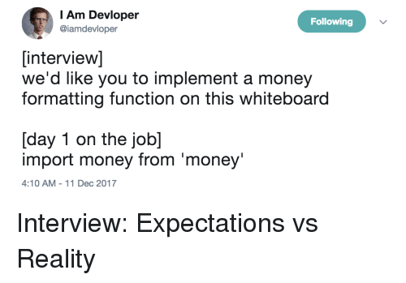
Live Coding - Introduction
Why
Live Coding Interview is Likely
Mock Live Coding Interviews – John/TAs
Many Approaches
In-Person or Online
Whiteboard or Computer
IDE or Notepad
Google
Ask Before Interview!
Goals
Solve Problems
Collaborate

Slide 11
Live Coding - Goals
Interviewers are looking for candidates who...
...ask questions to fully understand the problem.
...work towards a correct solution.
...has an understanding of the language syntax.
...demonstrates how to test the solution.
...addresses any bugs.
...can communicate their thought process.

Slide 12

Live Coding - Process
Gather Requirements
Break Problem Down
Pseudocode
Write Syntax (sometimes)
Test & Make Changes
https://education.launchcode.org/liftoff/videos/live-coding/

Slide 13

Gather Requirements
Ask Too Many Questions
Input/Output
Edge Cases/Validation
Write Out Requirements
Helpful Later
Establish Names & Data Structure

Slide 14

Break Problem Down
Restate The Key Points
Think out loud!
Rough Order Of Problems
Resist The Urge To Code
Stop, Turn Around, and Ask!

Slide 15
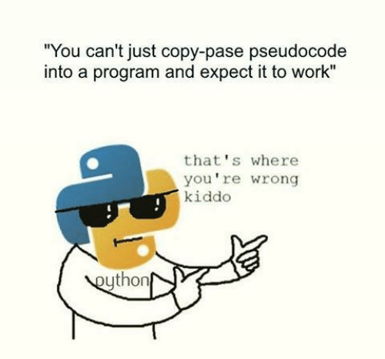
Pseudocode
No Code/Syntax
Still thinking out loud!
Focus On Control Structures
If/Then, Loops, etc
Examples
`If 5 is greater than 7, then stop`
`Loop from 1 to 100`
`If the result has a remainder, add 1`
`Print “hello world”`

Slide 16

Write Syntax
Now Start Writing Code
Talk It Out (Think out loud)
Don’t Be Afraid To Make Mistakes
Don’t Get Caught Up On Syntax
Write Clearly and Slowly

Slide 17
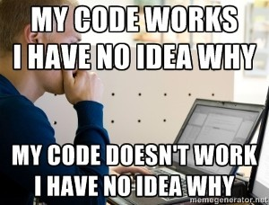
Test
Step Through Your Code (Out Loud)
Track Your Variables
Test Edge Cases
Shows thoroughness

Slide 18
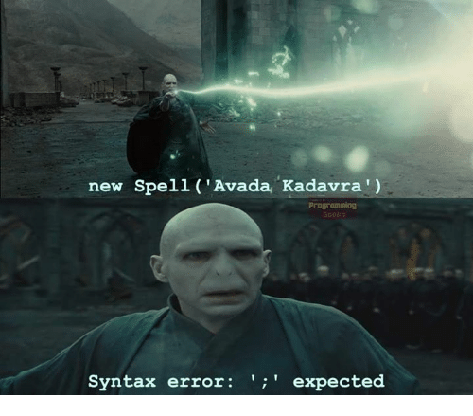
Make Changes
Fix Any “bugs” or missed branches
Discuss Improvements & Enhancements

Slide 19
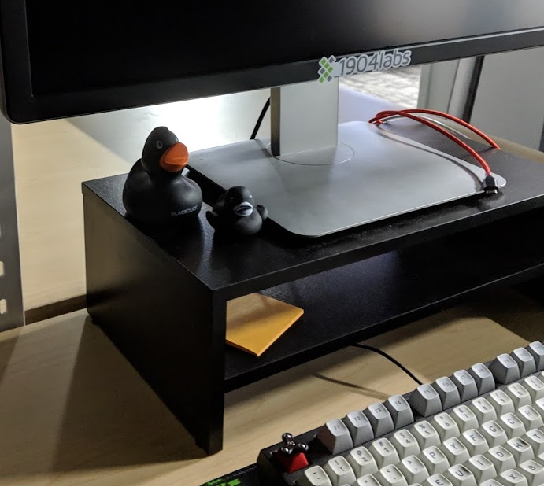
Practice Makes Perfect
https://www.hackerrank.com/
https://leetcode.com/
http://exercism.io/
https://checkio.org/

Slide 20
Demo - Live Coding

Slide 21
FizzBuzz
Write a program that prints the numbers from 1 to 100. But for multiples of three print "Fizz" instead of the number and for the multiples of five print "Buzz". For numbers which are multiples of both three and five print "FizzBuzz".

Slide 22
Project Reviews

Slide 23
Project Review
This is the first “Check-in”
Go over features and technologies selected
Landing page should be code-complete
First small feature should be code-complete (or close to it)
Make sure project timeline is still possible and adjust as necessary
AVOID SCOPE CREEP!
Final project needs to be code-complete with 3-5 features

Slide 24
Assignments

Slide 25
Assignment - Project Setup
https://education.launchcode.org/liftoff/modules/assignments/project-setup.html#assignment-project-setup
Push Existing Work
Update your `liftoff-assignments` repo to link to your new repo
Submit the assignment on Canvas with the above URL

Slide 26
Assignment - Online Profiles
https://education.launchcode.org/liftoff/modules/assignments/online-profiles.html#assignment-online-profiles
Update README.md
Resume (PDF)
GitHub
LinkedIn
Update your `liftoff-assignments` repo to link to profiles
Submit the assignment on Canvas with the above URL
Notes:
If you’re not comfortable uploading a resume, work with mentor
Ditto for LinkedIn or GitHub

Slide 27
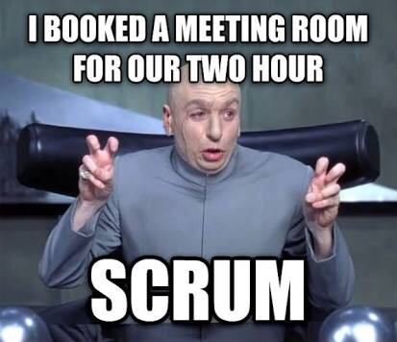
Activity - Scrum (15 mins)
~1 Minute Per Person
What You Did
What You’re Working On Next
Any Blockers
Notes:
Ableist, but the idea is that it’s short. If it works better sitting, please do.

Slide 28

Resume
Create a rough outline
Fill in Technical Details and Education
Add Work History
Edit and Review
Review with Group Member
Mentor Feedback

